Slide 1
FLUTTER EP11
Hello World

Slide 2
UI
Web
Emulator

Slide 3
CONTENT
Create Project (OK)
Build: Emulator, (OK), Web
Widget: Column, Row, ListView (ok)
Create navigator (ok)
Upload to Github

Slide 4
WIDGET
Single Child Widget: Container, Center
Multiple Child Widget: Column, Row, LitView

Slide 5
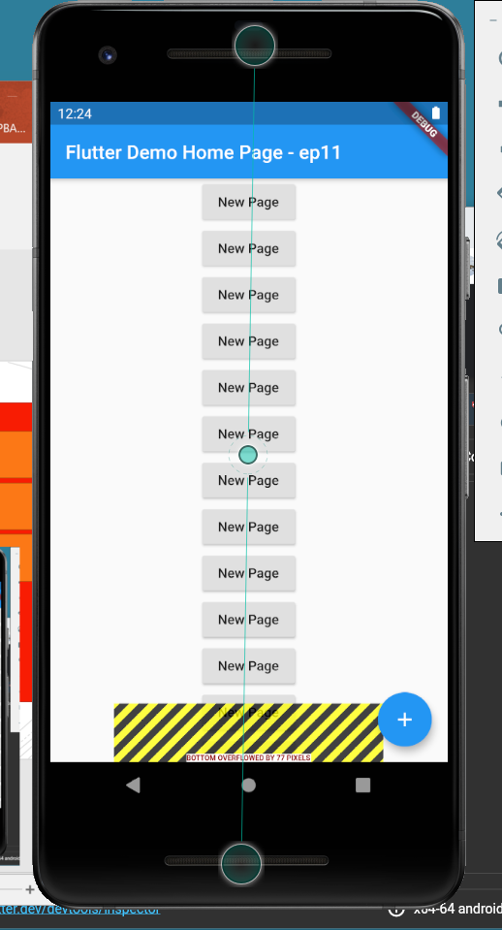
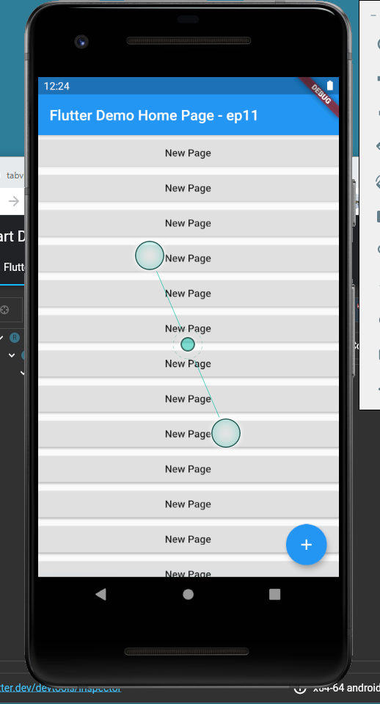
COLUMN/LISTVIEW
Column
ListView

Slide 6
ROW
Column

Slide 7
https://github.com/traitet/flutterep11.git

Slide 8
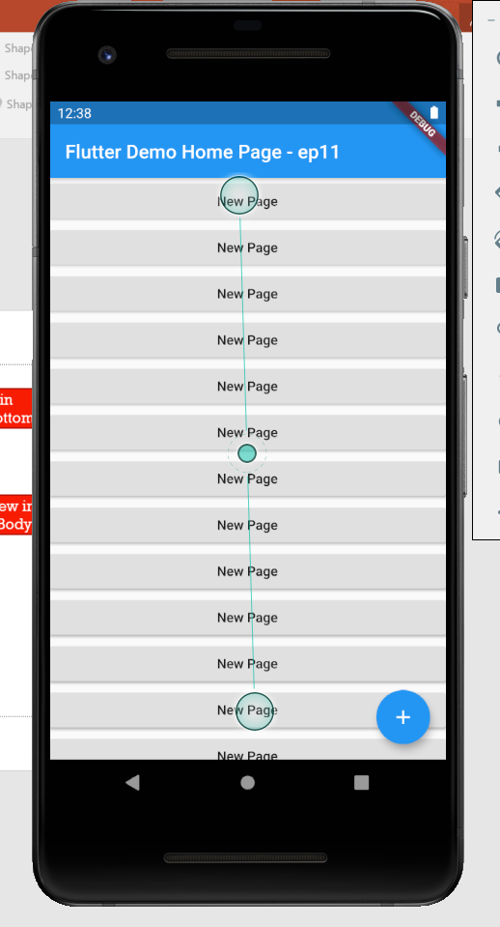
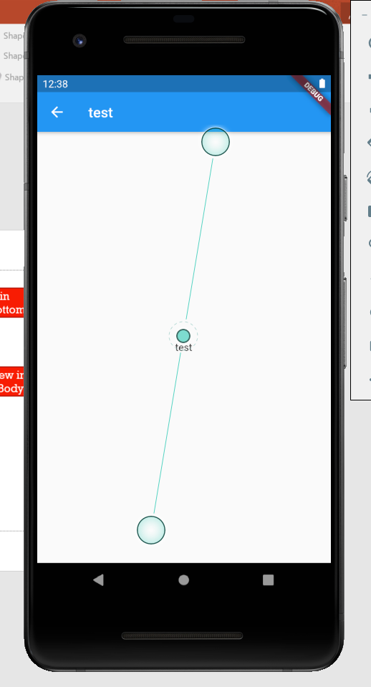

Slide 9
KEYWORD
Navigator
Single child widget
Multiple child widget
New Flutter Project
Widget: Column, Row, ListView Widget
Upload to github

